Slide 1
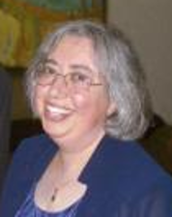
Presenter: Diane Theriault, MD Chief Scientific Officer, Osteoporosis Canada
Post-fracture care gap in the elderly: a frequently encountered barrier in FLS
Remember to complete the post Webinar Survey to let us know our goals were met and also there is a “comments” section so you can ask any questions of the presenter.

